Slide 1
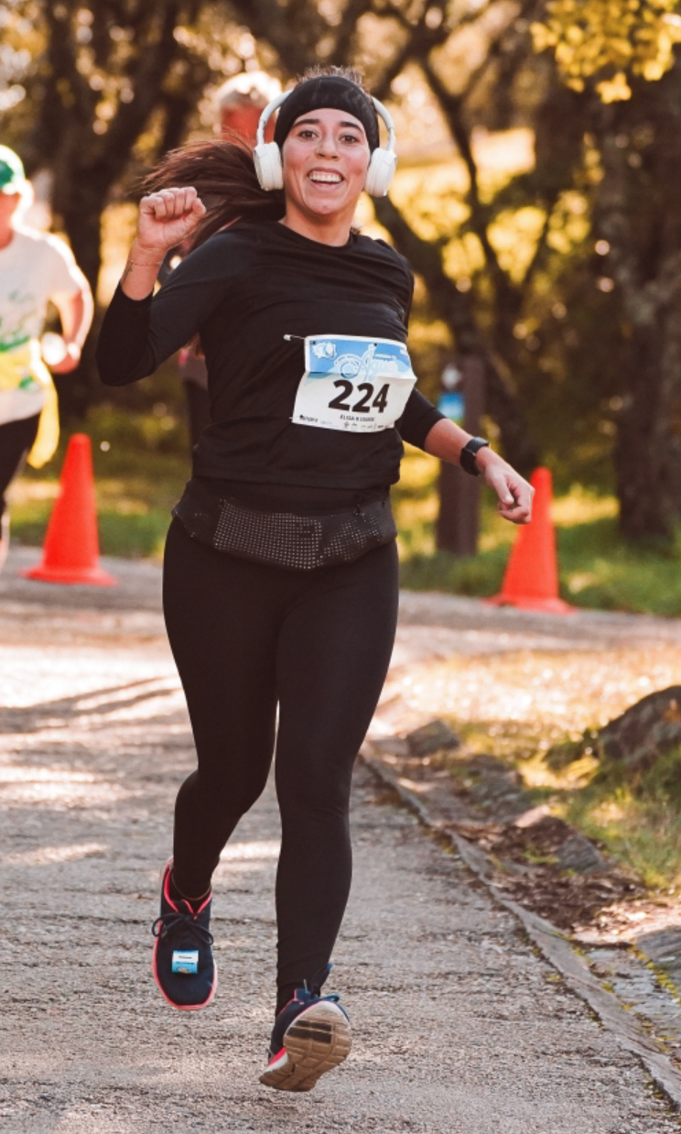
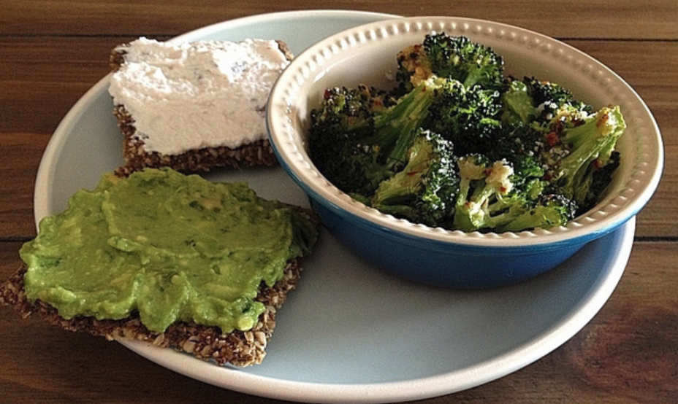
ML Architecture Person Detection
Person detected
NO Person detected

Slide 2
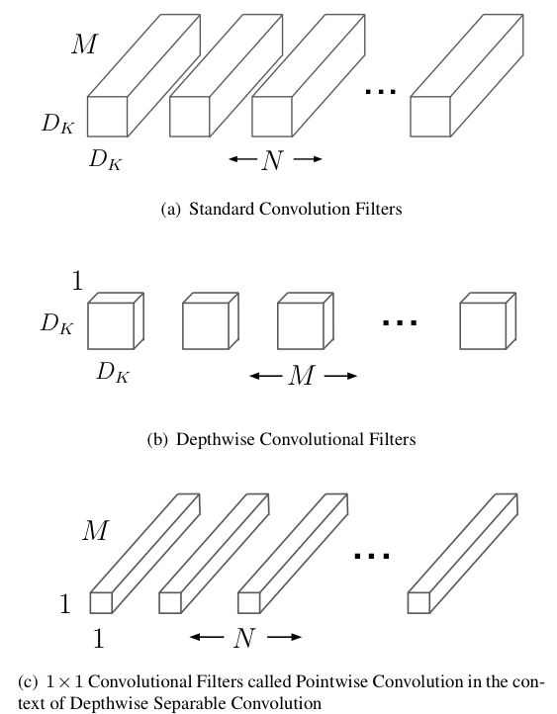
ML Architecture Person Detection
based on the MobileNets Architecture
split standard convolution into depthwise separable (depthwise+pointwise) convolution
→ fewer multiplications, reduces model size and computation time
MobileNets: Efficient Convolutional Neural Networks for Mobile Vision Applications, A. G. Howard et al., 2017

Slide 3
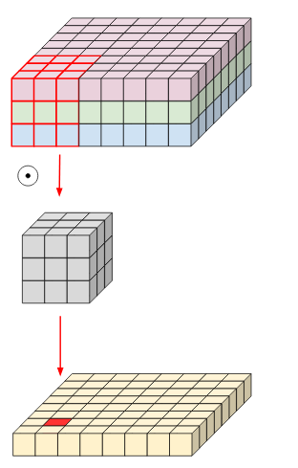
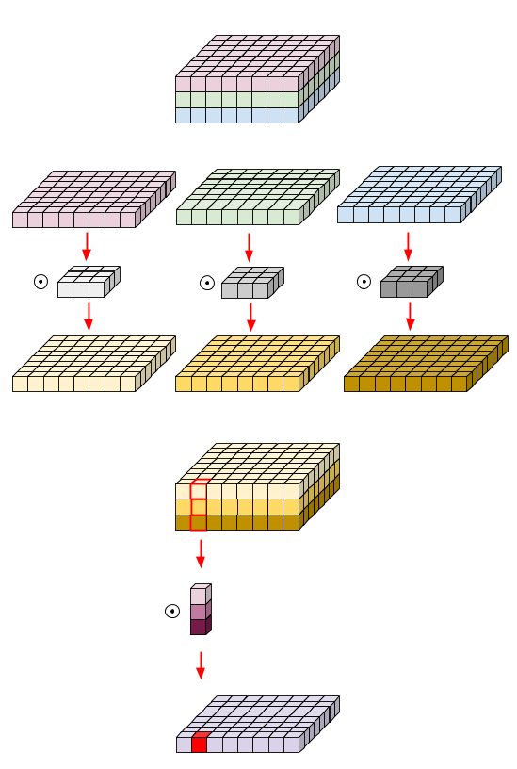
Depthwise separable Convolution
=
+
Convolution
Depthwise Convolution
Pointwise Convolution
https://eli.thegreenplace.net/2018/depthwise-separable-convolutions-for-machine-learning/

Slide 4

ML Architecture Person Detection
INPUT ([1,96,96,1])
DepthwiseConv
INPUT: grayscale int8 image (96x96 pixels)
OUTPUT(1x2 vector indicating probability for Person/No Person label)
int8-Model, model also makes use of quantization (therefore int32 and int64 values in quant layers)
→ rather large network, but repetitive architecture
31 Layers in total
DepthwiseConv
repeat this layer structure 13x (different weight/input dimensions)
PointwiseConv
AvgPool
PointwiseConv
Softmax
OUTPUT ([1,2])
Notes:
TF Lite File 300kB in size

Slide 5
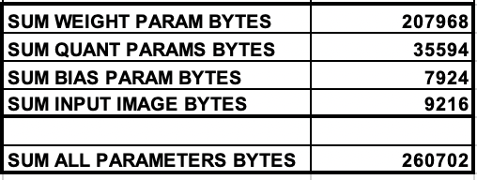
ML Architecture Person Detection
INPUT ([1,96,96,1])
DepthwiseConv
31 Layers in total
DepthwiseConv
repeat this layer structure 13x (different weight/input dimensions)
PointwiseConv
AvgPool
PointwiseConv
Softmax
OUTPUT ([1,2])
Notes:
TF Lite File 300kB in size

Slide 6
Depthwise Convolution
groups = 1
output
weights
sum
input
Notes:
TF Lite File 300kB in size

Slide 7
Depthwise Convolution, groups = 1
output
weights
sum
input
Notes:
TF Lite File 300kB in size

Slide 8
Depthwise Convolution, groups = 1 for layer 1
weights
input
output
1x96x96x1
1x48x48x8
stride = 2
Notes:
TF Lite File 300kB in size

Slide 9
Depthwise Convolution, groups = channels
output (stride=1)
output (stride=2)
1xHxW
weights
1xH/2xW/2
input
1xHxW
1xH/2xW/2
1xHxWxC
1xHxW
1xH/2xW/2
1xHxW
1xH/2xW/2
Notes:
TF Lite File 300kB in size

Slide 10
Average Pooling
A1
A2
B1
B2
A3
A4
B3
B4
∅A
∅B
C1
C2
D1
D2
∅C
∅D
C3
C4
D3
D4
Notes:
TF Lite File 300kB in size

Slide 11
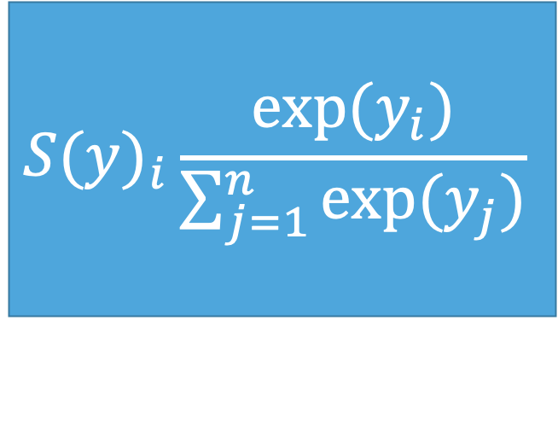
Softmax
used as last activation function to normalize output to a probability distribution
→ scales logits/numbers into probabilities
Output Probabilities
Logits
Softmax
Classes
-128
68
$${S(y)}_{i}\frac{exp⁡(y_{i})}{\sum_{j=1}^{n}{exp⁡(y_{j})}}$$
0.05%
99.95%
Not a Person
NN Layer Output
Person
Notes:
TF Lite File 300kB in size

Slide 12
Quantization
float32
-1034.5
21359.2
int8
0
255
Notes:
Quantization of weights/bias

Slide 13
Quantization
Convolution
Multiplication with Quantization parameters
Addition with Quantization parameters
Shifting with Quantization parameters
int32
int64
int64
int8
Notes:
Quantization of activation values

Slide 14
ROADMAP C Implementation Person Detection
3. C implementation of ML Model
5.Acceleration with HyCube CGRA
1. Train ML Model
2. Extract parameters from trained model
4. Deploy model on Manuca
Train Model based on the MobileNet with the VWW COCO Dataset with TF
Accuracy: 81.5%
implement the ML model in native C to allow an acceleration with the HyCube CGRA in the future
Run the TFLite and the C model on the Manuca Microcontroller and evaluate computation speed and energy consumption as well as accuracy
in the future the C implementation shall be accelerated with the HyCube CGRA to achieve even faster and more efficient results
Extract weights, bias and quantization parameters from the trained TFLite model for the C implementation

Slide 15
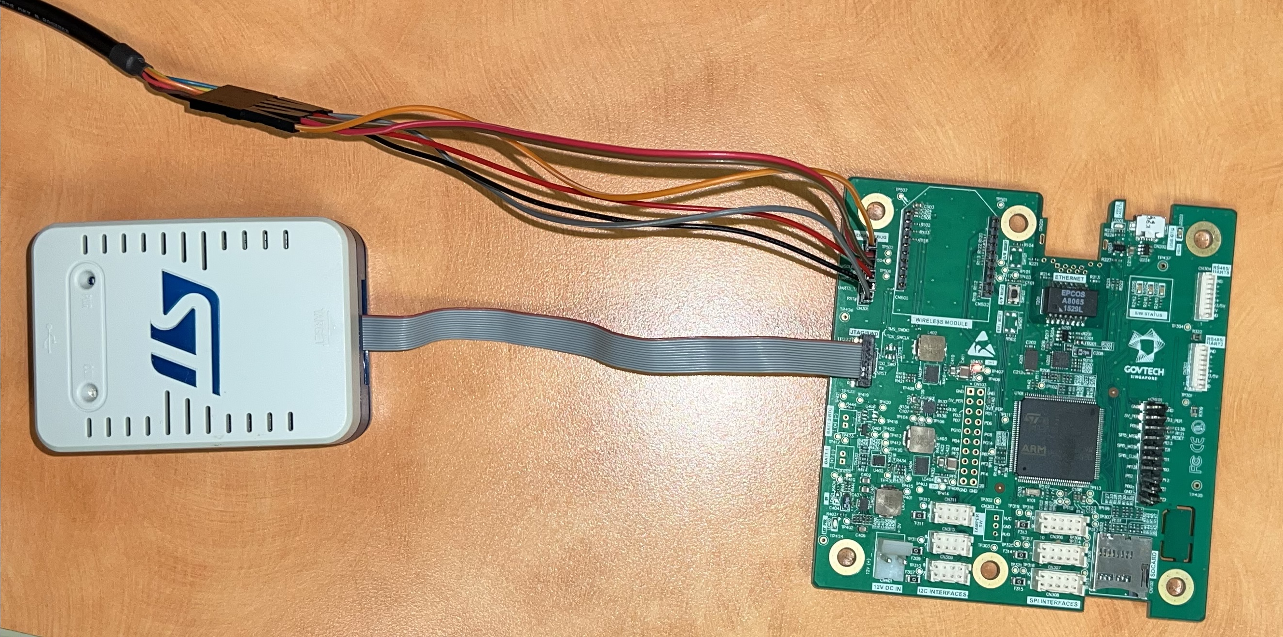
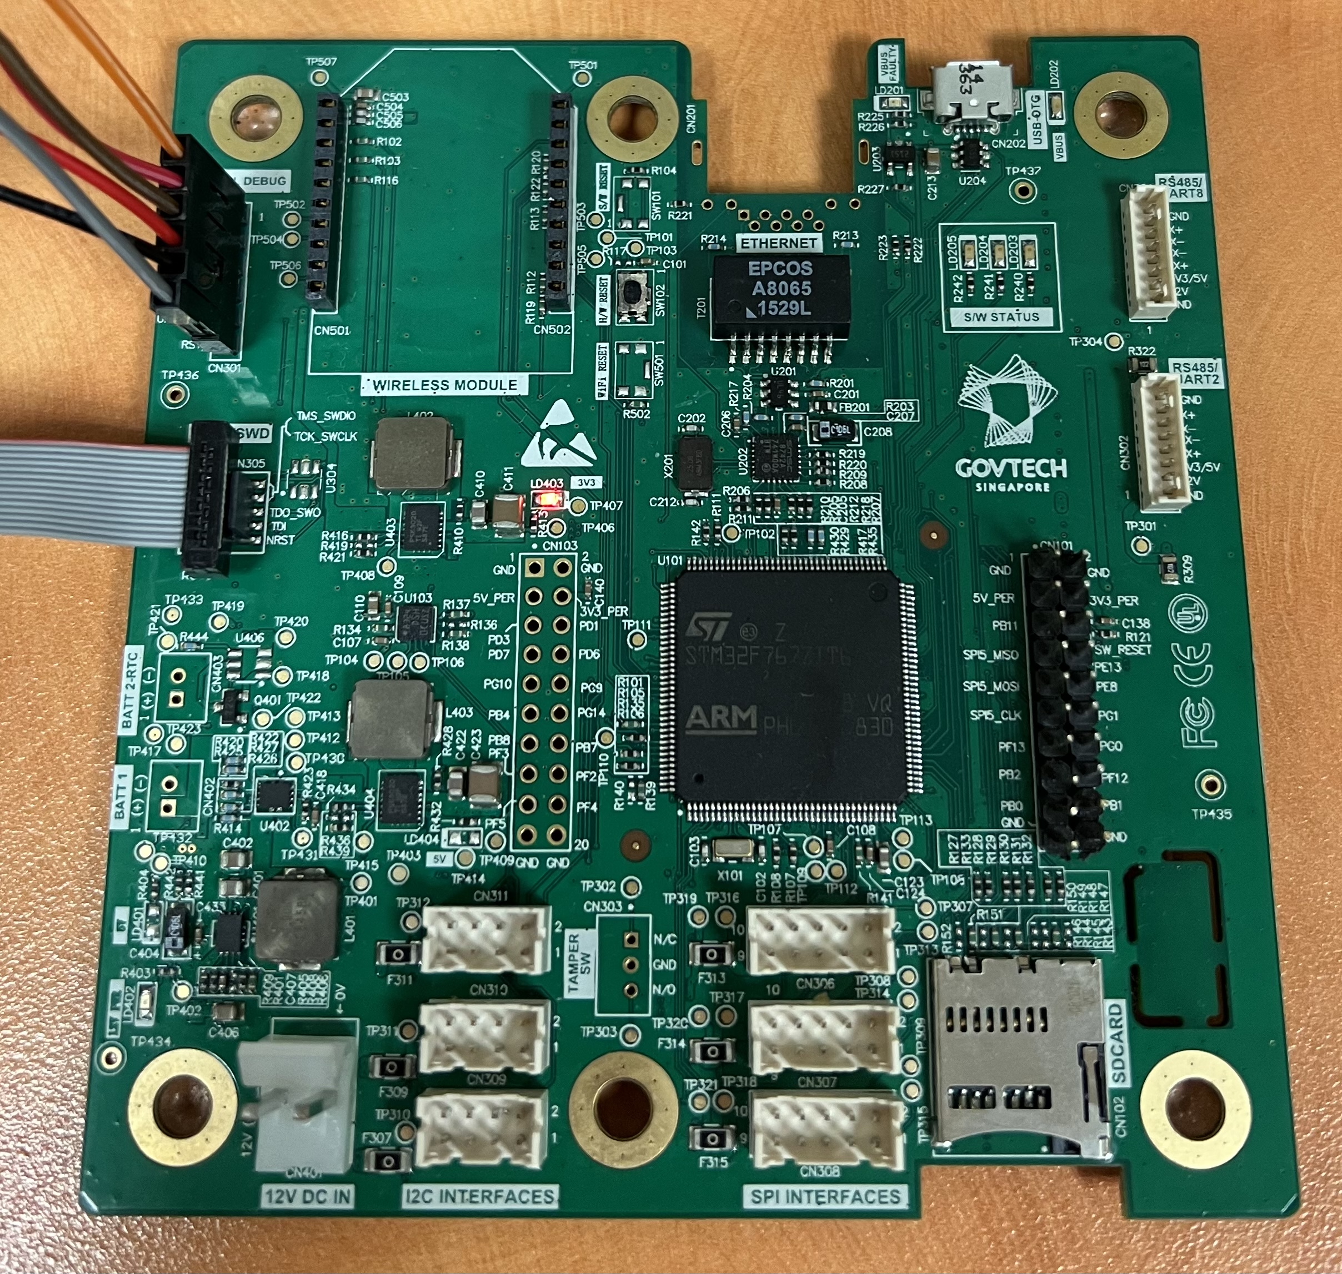
Manuca Board
MCU: STM32F767ZI, based on ARM Cortex M7 CPU architecture
2MB Flash
512kB SRAM
Debug via Serial UART interface

Slide 16
Optimizations done for C Implementation
to minimize SRAM usage:
make model parameters local, not global
partition large layers with a lot of parameters into smaller portions (just for layer 27, 256x256 weight dimension)
work with smaller storage size if applicable (e.g.: int8 instead of int32 for quantization shift param, int16 instead of int32 for bias)
to optimize time per inference
make model parameters global to minimize flash memory access

Slide 17
Analysis mbed implementation
Implementation | TFLite | Native C (params are local variables) | Native C (params are global variables)
Time per Inference | 98,7 ms → 10.13 fps | 430 ms → 2.33 fps | 360 ms → 2.78 fps
Power [W] | 0.75 | 0.7 | 0.73
Voltage [V] | 5.08 | 5.08 | 5.08
Current [A] | 0.148 | 0.139 | 0.144
Energy [J] | 0.752 | 0.70612 | 0.732
SRAM usage | 144 kB | 16.4 kB | 202.3 kB
Flash usage | 97.5 kB | 308.1 kB | 303.8 kB
Binary size | 420 kB | 309.6 kB | 284 kB
Notes:
TF Lite File 300kB in size

Slide 18
Analysis mbed implementation
Implementation | TFLite | Native C (params are local variables) | Native C (params are global variables)
Time per Inference | 98.7 ms → 10.13 fps | 430 ms → 2.33 fps | 360 ms → 2.78 fps
Power [W] | 0.75 | 0.7 | 0.73
Energy [J] | 0.752 | 0.70612 | 0.732
SRAM usage | 144 kB | 16.4 kB | 202.3 kB
Flash usage | 97.5 kB | 308.1 kB | 303.8 kB
Binary size | 420 kB | 309.6 kB | 284 kB
fastest implementation
most power efficient
implementation
Notes:
TF Lite File 300kB in size

Slide 19
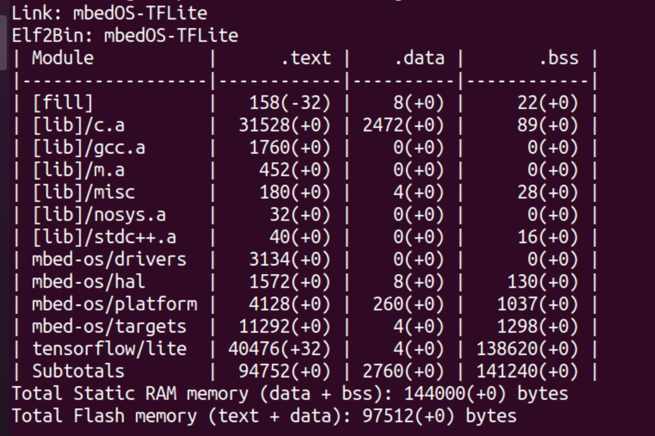
Analysis mbed TFLite implementation
Notes:
TF Lite File 300kB in size

Slide 20
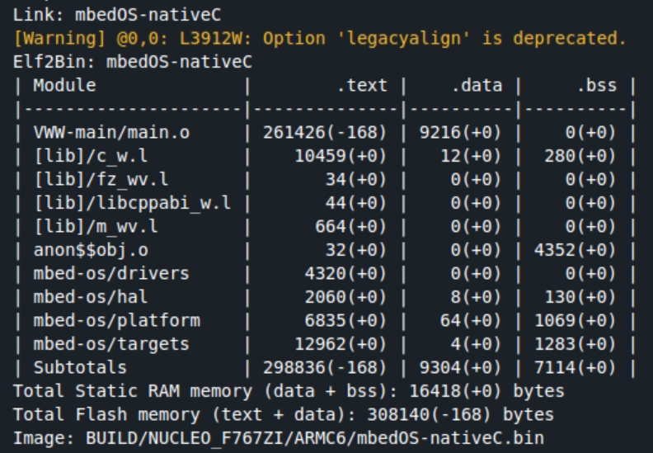
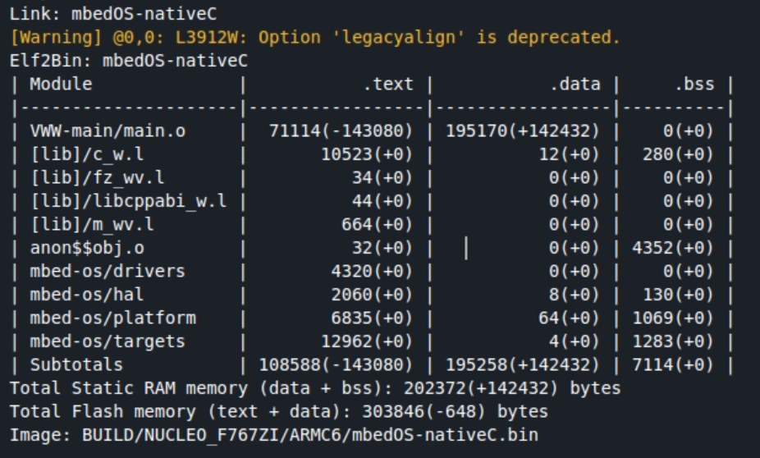
Analysis mbed native C implementation
parameters as local variables
parameters as global variables
Notes:
TF Lite File 300kB in size

Slide 21
Possible Future Improvements
minimize model size
use a smaller input size (currently 96x96 pixels)
use fewer convolution layers
→ could degrade accuracy
accelerate convolution layer (matrix multiplication) with CGRA
it will probably be necessary to add a flash memory to the CGRA as some of the layers are rather large and with the current setup it would create a large communication overhead
Notes:
TF Lite File 300kB in size

Slide 22
ROADMAP Manuca-FPGA SPI connection
1. Manuca: SPI Output
3.physical connection FPGA- Manuca
2. Bit to Hex pattern
4.RD/WR via SPI
5. Integrate Endian into mbedOS
establish RD/WR via SPI connection between Manuca board and FPGA and check the correctness of the communication
→ WIP, script done, still needs to be tested
Check if Manuca extension Board generates the expected SPI output
→ DONE
Replace the PC and QSPI controller with the Manuca Board
establish the physical connection for SPI communication
→ DONE
Write python script that converts the bit pattern received from MISO to hex pattern
1011 1111 → xFD
→ DONE
Integrate the endian switch into the mbedOS code to make the python script superfluous

Slide 23
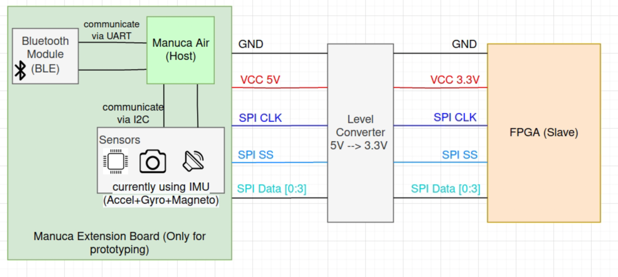
Manuca-FPGA SPI connection

